Slide 1
Giving Hope Wings: Free Flights for People in Need

Slide 2
About Us
OUR MISSION: To deliver health and hope using donated flights to serve people with healthcare or other compelling human needs.
In the air, ANGEL FLIGHT WEST links volunteer pilots and commercial airline partners with people whose non-emergency health needs require air transportation to access care. On the ground, volunteer drivers ferry passengers to and from their departure and destination airports.
36+ YRS
DEDICATED
SERVICE
$39.9m
DONATED
FLIGHTS
1,500+
VOLUNTEER
PILOTS
$0
PATIENT
COST

Slide 3
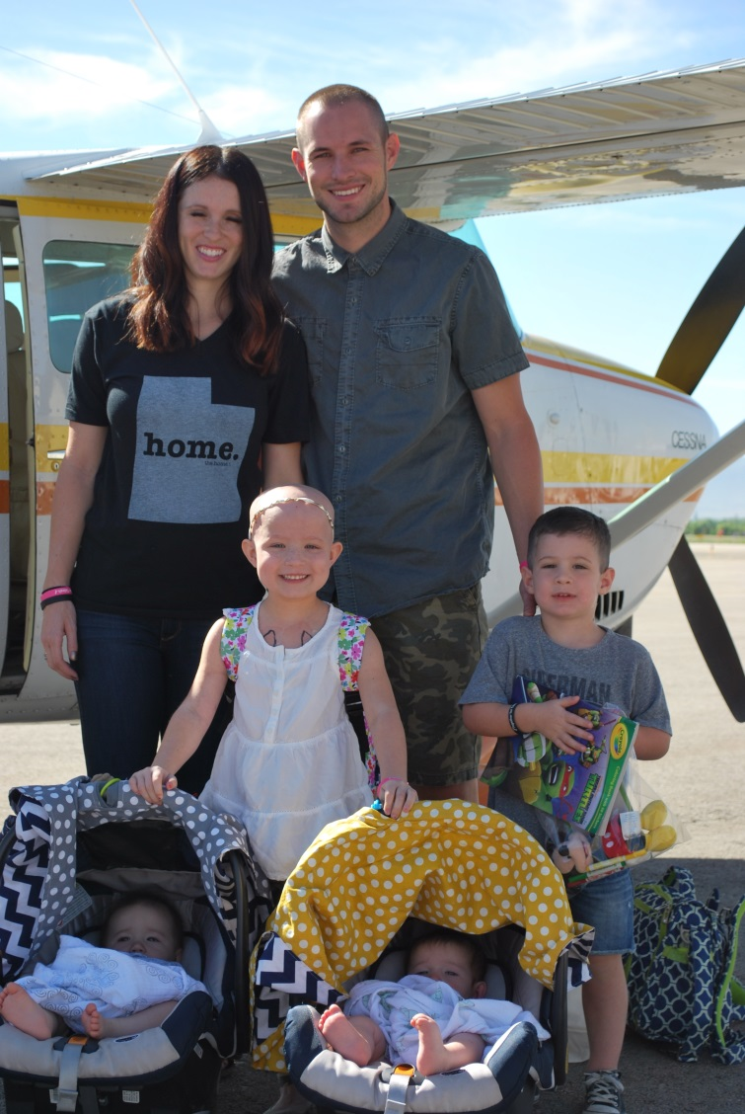
Who Do We Serve
Patients traveling for non-emergency care at major research hospitals, children’s hospitals, specialized treatment centers and more.
Kids attending special needs camps, such as those for burn survivors or cancer patients.
Domestic violence survivors in need of relocation.
Veterans and active duty military personnel.
Disaster relief efforts.
Blood for non-profit blood banks
People with other compelling human needs.

Slide 4
Who Qualifies For Our Help
PASSENGERS MUST . . .
Be medically stable and ambulatory.
Have a scheduled appointment with a minimum of one-week notice.
Have a financial need or other compelling consideration (i.e. immune compromised, geography, etc.).
Traveling a distance less than 1,000 nautical miles.
Be capable of sitting upright wearing safety belt for duration of flight.
If flying privately, be able to fly in a small unpressurized aircraft.

Slide 5
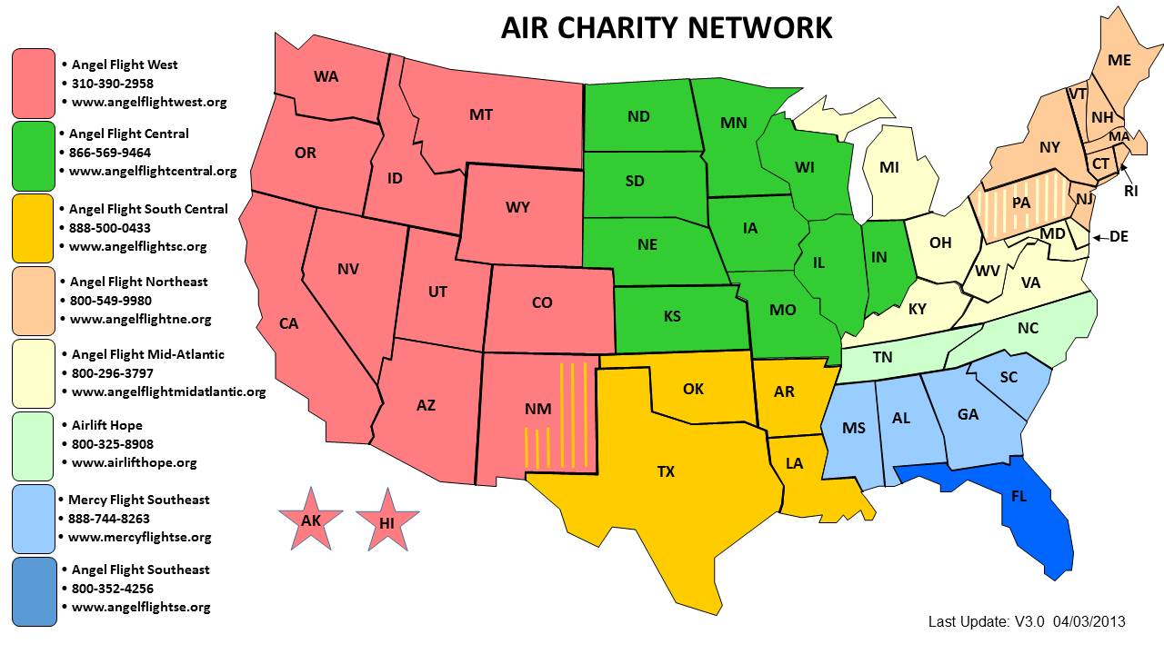
Where We Fly
Toll Free – Request routed by area code of the caller
(877) 621-7177
www.aircharitynetwork.org

Slide 6
Types of Flights
Pre-Flight Planner
Volunteer Pilots
Primarily small, single-engine aircraft
Typically 4-6 seats on average
Piloted by AFW volunteers
Limited to 1,000 mile flights
If passenger is traveling more 300 miles, flight split into 2- or 3-leg relays, with a different pilot flying each segment

Slide 7
Types of Flights
Commercial Partners/Alaska Airlines
Donated commercial tickets
Typically for passengers in Alaska and Hawai’i
Occasionally used as backup plan if a passenger’s return flight cancels due to weather
Compassion flights at AFW discretion using donated miles

Slide 8
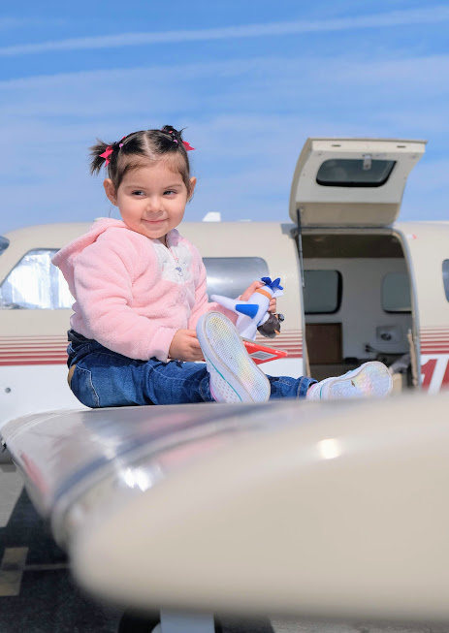
Requesting a Flight
Request at www.angelflightwest.org or by calling (310) 390-2958.
Initial request can come directly from passenger or medical/social work professional.
Repeat passengers can request additional flights directly after initial flight.

Slide 9
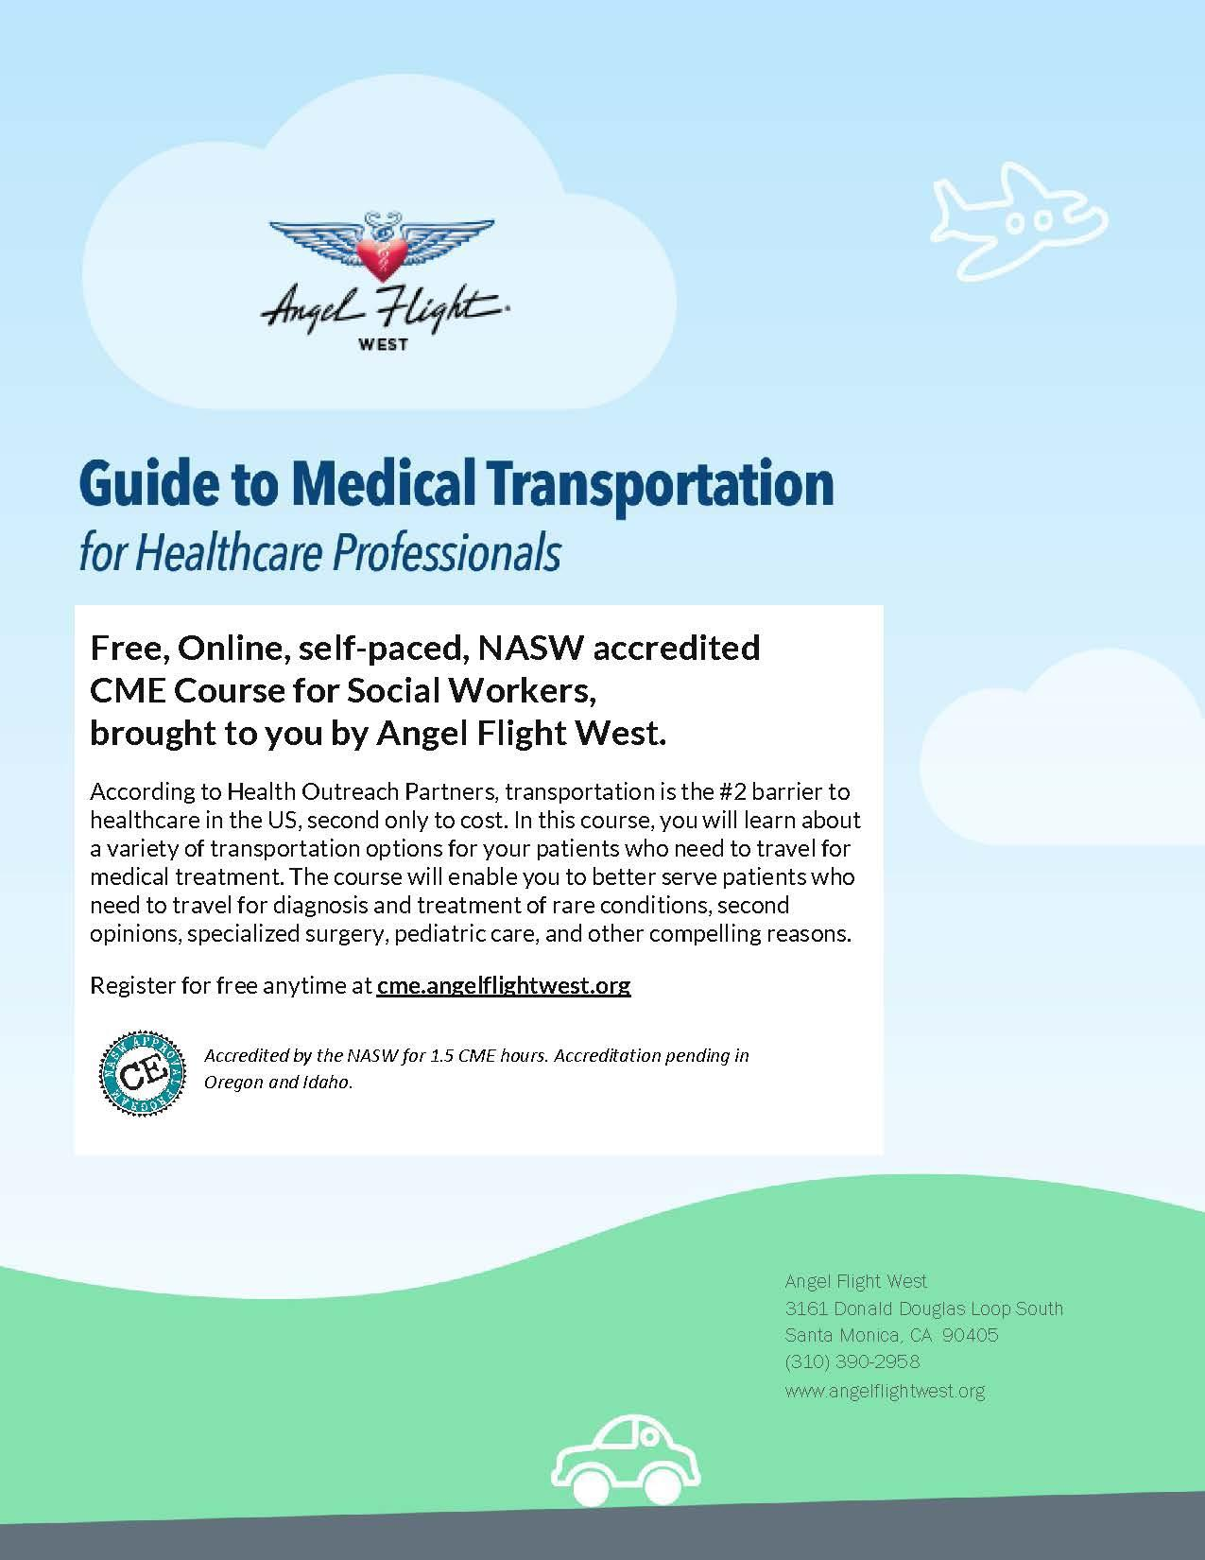

Slide 10
Contacts
For more information about Angel Flight West
please visit our website:
www.AngelFlightWest.org
(310) 390-2958
info@angelflightwest.org
Ivan Martinez, Director of Outreach
(310) 390-2958 ext.115
IvanM@angelflightwest.org

